Slide 1
Business Case 2
Needs-based recommendation systems,
collaborative filtering, Next Best Actions Best Actions
Alessandro Del Vitto
Michele Di Sabato
Rita Numeroli
Andrea Puricelli
Raffaella D'Anna

Slide 2
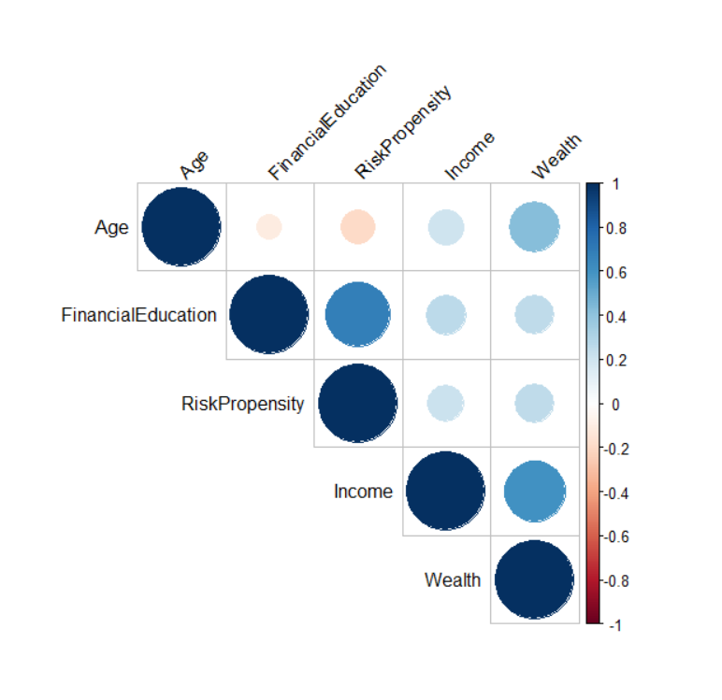
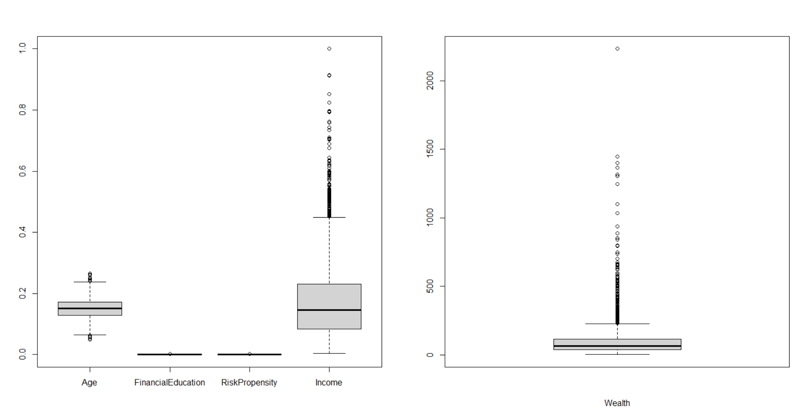
DATASET EXPLORATION: Boxplot and Correlation Plot

Slide 3
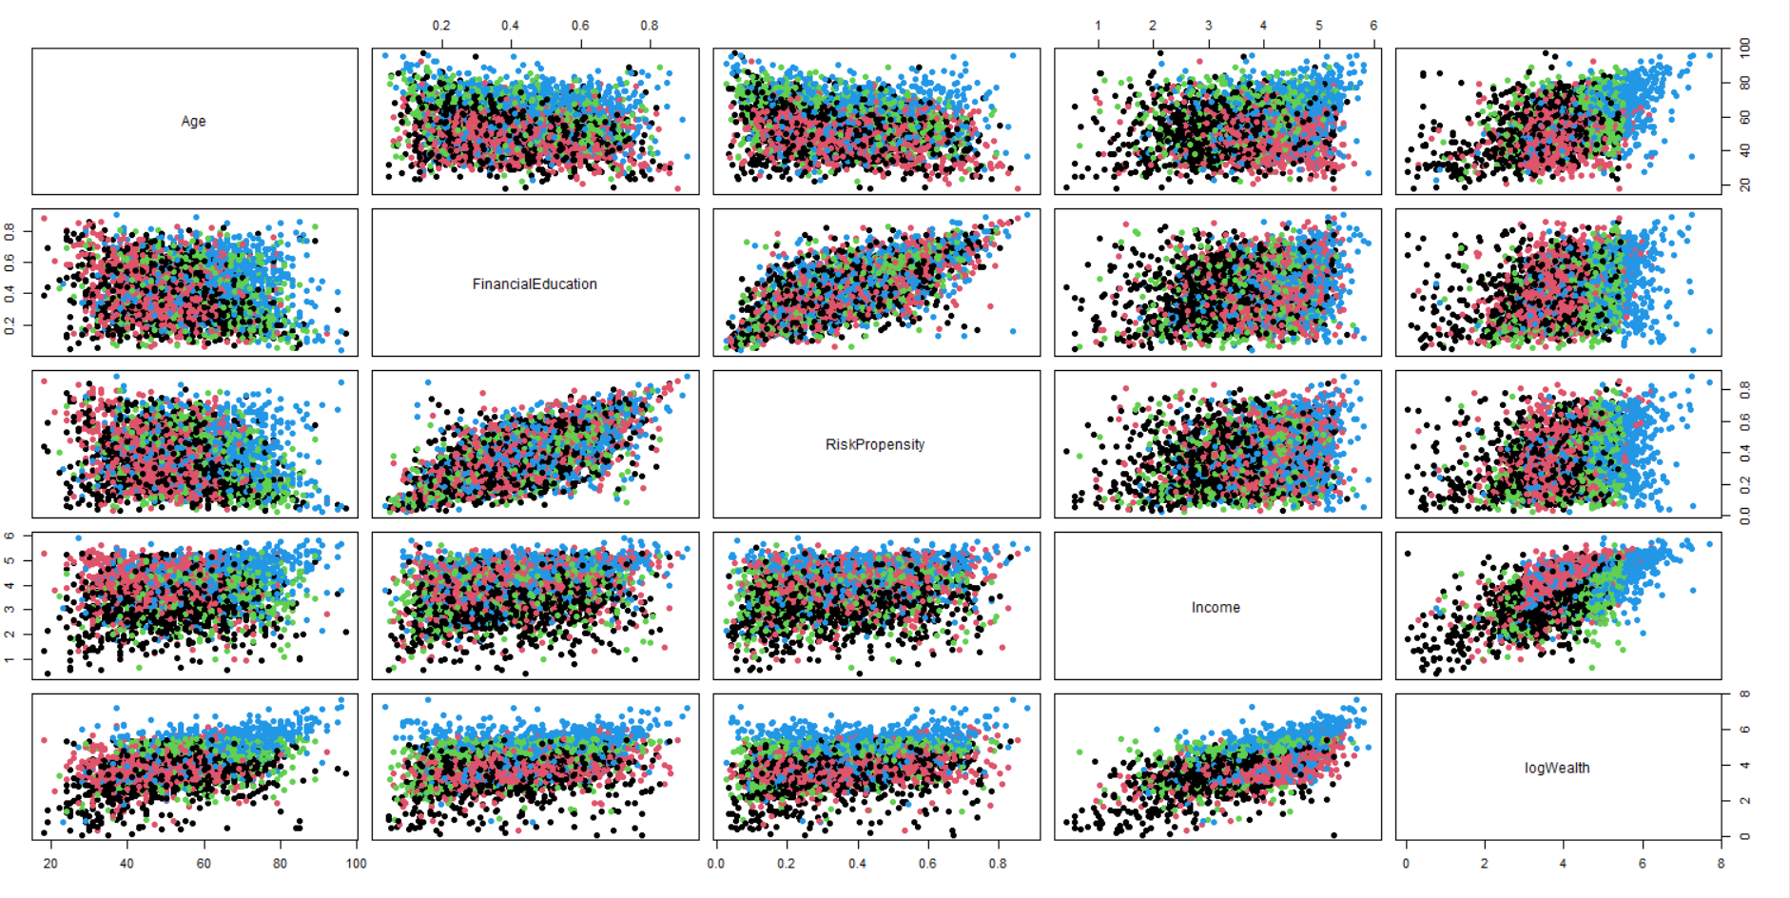
DATASET EXPLORATION: Pairplot

Slide 4
THE PROBLEM : Two approaches
Two Classes
Income Investment
Multi Class
0 : No investment
2 : Accumulation Investment only
0 : No accumulation
1 : Income Investment
Accumulation Investment
1 : Income Investment only
3 : Both
0 : No income investment
1 : Accumulation
Train two independent algorithms (NNs/RFs/...)
Train one single algorithm

Slide 5
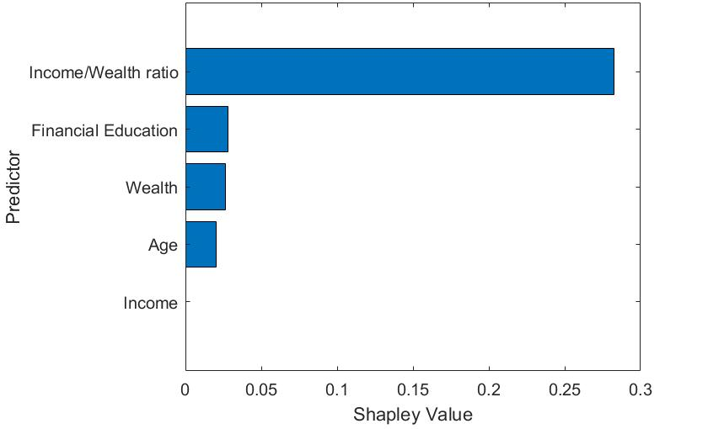
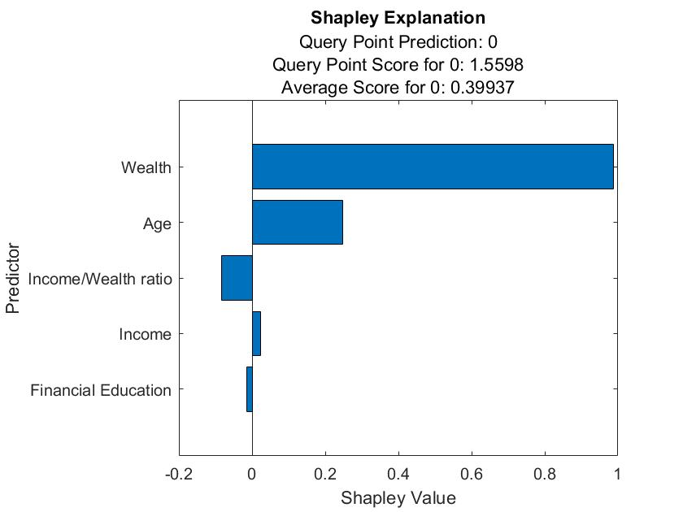
APPROACH 1: Two classes
A) Random Forest with Bagging
Shapley Explanation
a) Accumulation
b) Income

Slide 6
APPROACH 1: Two classes
A) Random Forest with Bagging
Performance Measures
a) Accumulation
b) Income
Performance Index | Score
Precision | 0.8671
Recall | 0.7807
F1 | 0.8216
Performance Index | Score
Precision | 0.9172
Recall | 0.6115
F1 | 0.7337

Slide 7
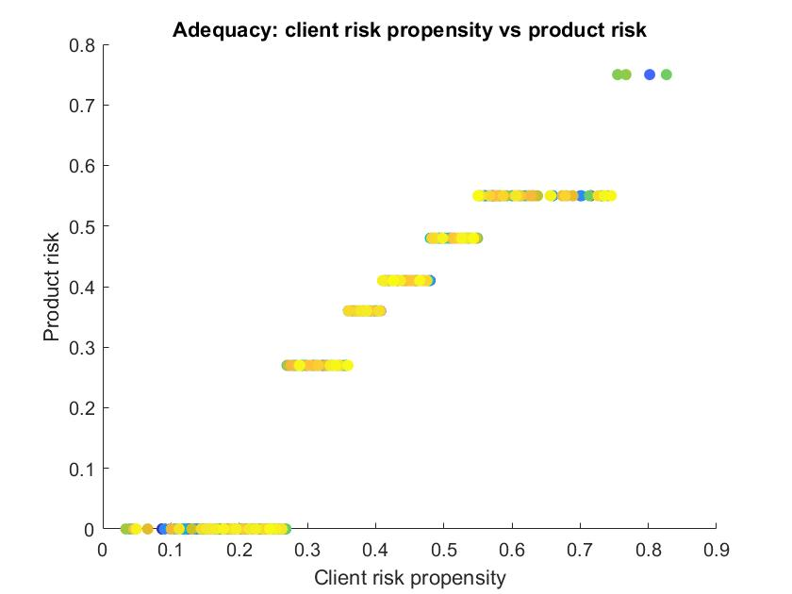
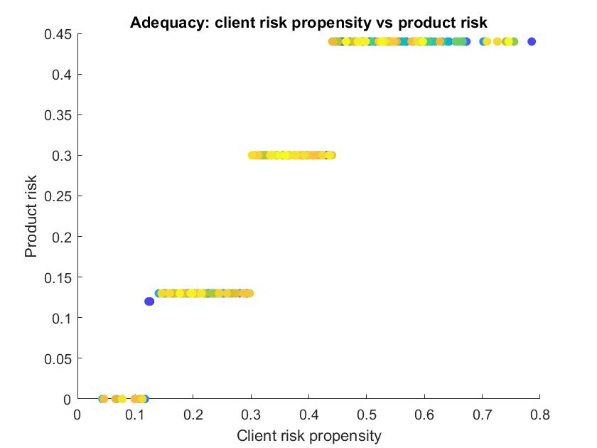
APPROACH 1: Two classes
A) Random Forest with Bagging
Recommendations Adeguacy
a) Accumulation
b) Income

Slide 8
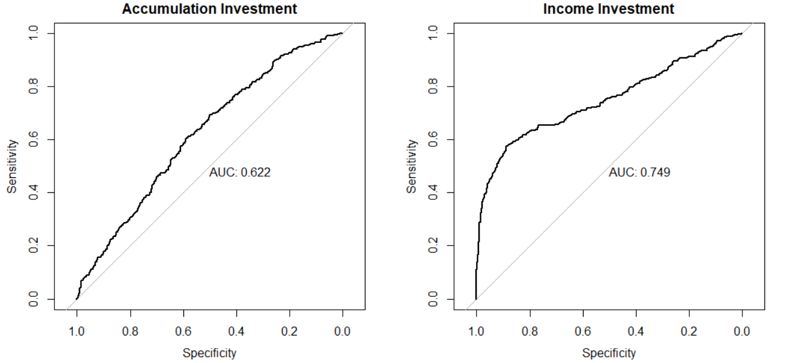
APPROACH 1: Two classes
B) Logistic Regression
IncomeInvestment ~ Age + RiskPropensity + logWealth + I(Income/Wealth)
AccumulationInvestment ~ Age + RiskPropensity + logWealth + I(Income/Wealth)

Slide 9
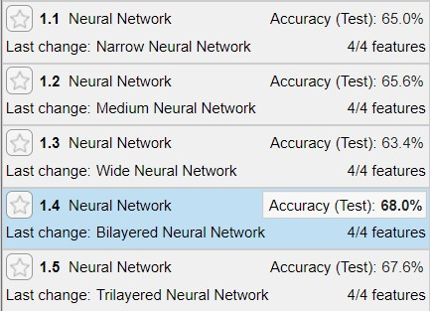
APPROACH 2: Four classes A) Neural Networks
Model selection

Slide 10
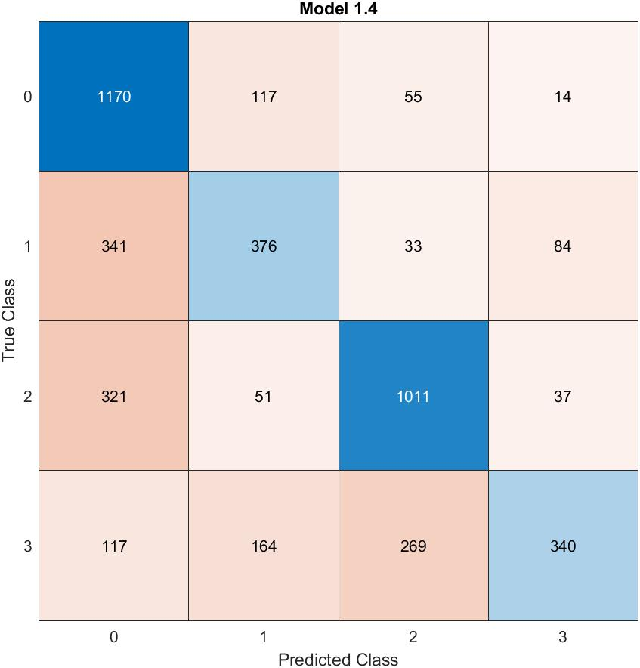
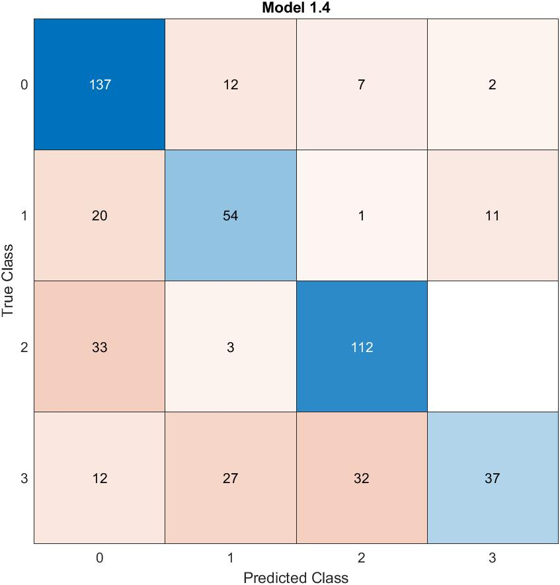
APPROACH 2: Four classes A) Neural Networks
Confusion Matrixes of best model

Slide 11
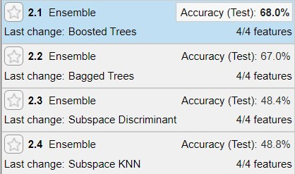
APPROACH 2: Four classes B) Random Forest
Model selection

Slide 12
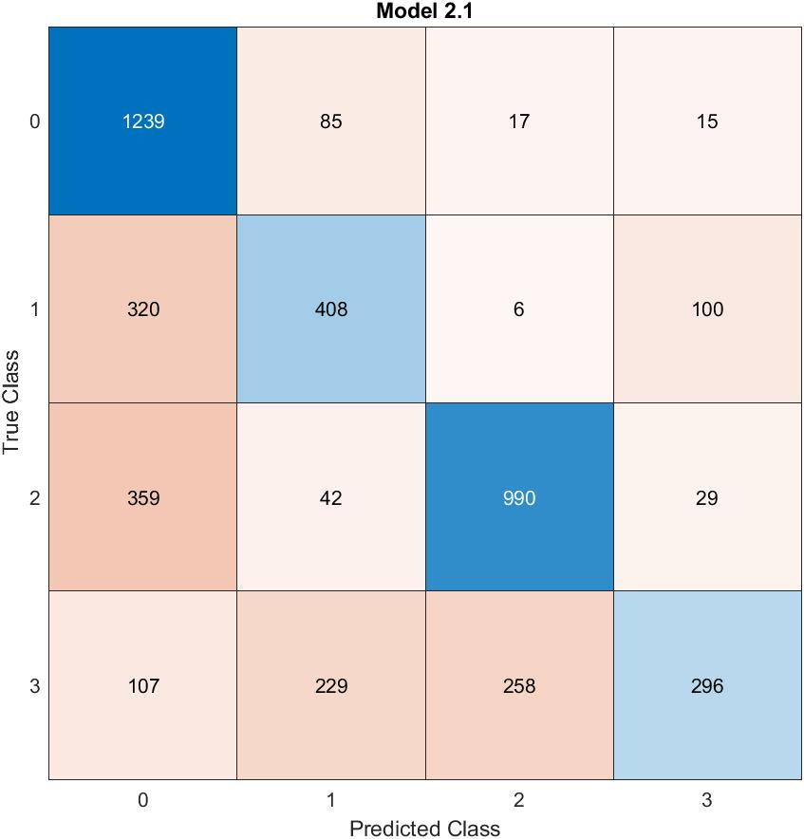

APPROACH 2: Four classes B) Random Forest
Confusion Matrixes of best model

Slide 13
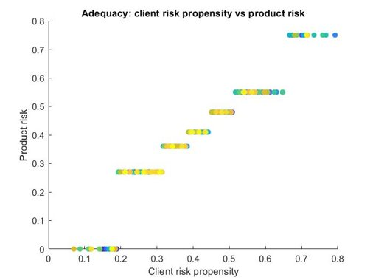
APPROACH 1: Two classes
An alternative recommendation system
A) Random Forest with Bagging for accumulation
Max Min NBA System
L1 NBA System

Slide 14
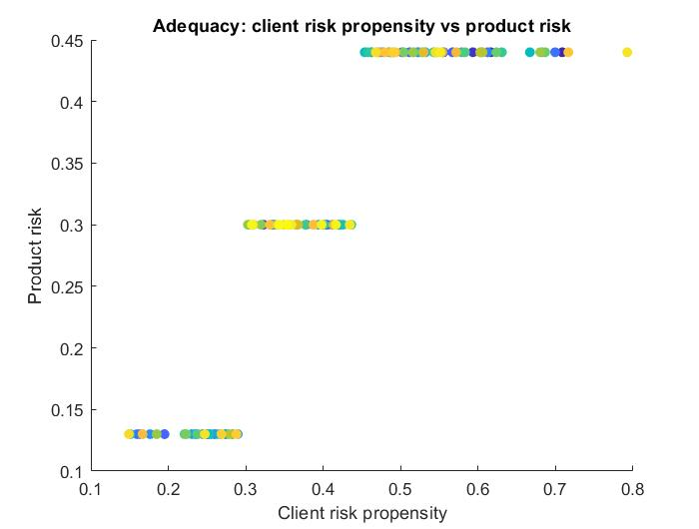
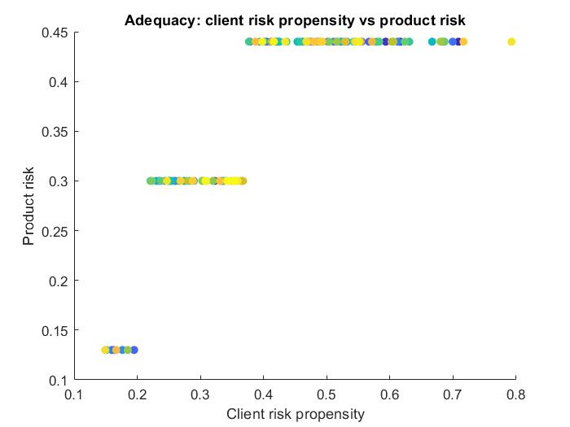
APPROACH 1: Two classes
An alternative recommendation system
A) Random Forest with Bagging for income
Max Min NBA System
L1 NBA System

